Slide 1
How Does Policy Affect Gambling Activity by State?
Liam Riener and Kieran Santos

Slide 2
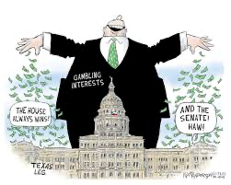
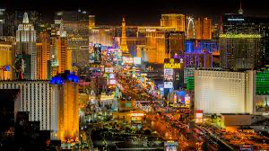
DATA EXPLORATION AND MANIPULATION
Data from UNLV gaming library
Through 2024, covers NV (1984-2023), PA (2012), NY (2016), MD (2013)
Older federal policy viewed through Nevada lens, makes sense for Las Vegas
Federal policy and state level policy in competing states and states w/ data

Slide 3
DIFFICULTIES/INCONSISTENCIES IN DATA
Inconsistent years, variables, categorizations by state
Maryland: https://gaming.library.unlv.edu/reports/md_monthly.pdf
GTR, # VLTs, GTR/VLT/Day, %Δ
New York: https://gaming.library.unlv.edu/reports/ny_monthly.pdf
Table Games, Table Drop, Hold %, Slots, Credits Played, Table/Slot GGR,Total GGR, WSD/WTD: Win/Slot (Table)/Day, VGM: Video Gaming Machine,Win/VGM/Day
Nevada: https://gaming.library.unlv.edu/reports/NV_1984_present.pdf
Year, %Δ, #Loc, #Games, Game Rev, #Slots, Slot Rev, Total Rev
Pennsylvania: https://gaming.library.unlv.edu/reports/pa_monthly.pdf
GTR, Table Rev, Sports Rev, Interactive Rev, Total Rev, %Δ:

Slide 4
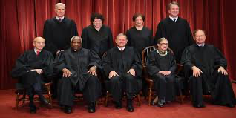
FEDERAL POLICY
Sports
1992- Professional and Amateur Sports Protection Act: always legal in NV
2018- SCOTUS overturns PASPA- limits on state sovereignty
NY legalizes in-person 2013, online in 2022, PA legalizes in-person 2017, online opens in 2019, MD legalizes in-person Dec 2021, online Nov 2022
Casinos
NV legalizes in 1931 b/c of Great Depression
Native American reservations
Atlantic City legalized gambing in 1979
1989- intoxication shields gambling debt
Riverboat gambling/casinos

Slide 5
STATE POLICY
PA: October 2017 bill allows casino gambling at truck stops, airports, online
NY: early legalization in nearby NJ means NY is playing catch-up, estimated 20% of NJ gamblers from NY. More restricted, 19 total casinos, casino numbers historically capped. Nov 2021 law enforces 51% tax on online sportsbooks (for reference NJ is 14%)
MD: 2019- gambling decriminalized, running illegal operation becomes misdemeanor
NV: 1998- CA law allows Native American reservations to compete with NV casinos. Feb 2013- state allowed to enter pacts with other states to offer internet gambling

Slide 6

RESPONSE VARIABLES OF INTEREST
Total Sports Betting Handle per State
How much money people are wagering via different sources.
Annual State Tax Revenue from Online Sportsbooks
Compare different states.
Decline in NJ Online Betting Volume After NY Legalized Online Sports Betting
Cross-state betting behavior. Before-after comparison using NJ’s mobile betting revenue or user geolocation data.
Number of Problem Gambling Helpline Calls per State
Discuss potential social costs of expanding access. Compare states with early or aggressive online legalization vs. those that don’t allow it.

Slide 7
Sources
Data
https://gaming.library.unlv.edu/
Policy articles
https://www.healdsburgtribune.com/us-gambling-culture-history/
https://digitalscholarship.unlv.edu/cgi/viewcontent.cgi?article=1223&context=grrj
https://playtoday.co/blog/history-of-gambling-in-the-us/
https://pluralpolicy.com/blog/sports-betting-laws/
https://spacecoastdaily.com/2024/11/the-history-and-legality-of-online-gambling-in-the-us/#
https://en.wikipedia.org/wiki/History_of_gambling_in_the_United_States
State level policy articles
https://www.findlaw.com/state/maryland-law/maryland-gambling-laws.html
https://en.wikipedia.org/wiki/Gambling_in_Pennsylvania
https://www.findlaw.com/state/new-york-law/new-york-gambling-laws.html
https://www.findlaw.com/state/nevada-law/nevada-gambling-laws.html
https://www.nevadaresorts.org/history/
https://www.forbes.com/sites/qai/2021/11/12/new-york-takes-a-gamble-with-51-tax-on-online-sports-betting/ https://jamescrawfordlaw.com/insights/blog/firm-news/gambling-in-maryland-you-bet-heres-whats-legal#:~:text=Gambling%20has%20a%20long%20history,of%20gambling%20on%20the%20ponies!

